Slide 1

Behavioral Economics
HE3001, Microeconomics 3 Nanyang Technological University

Slide 2

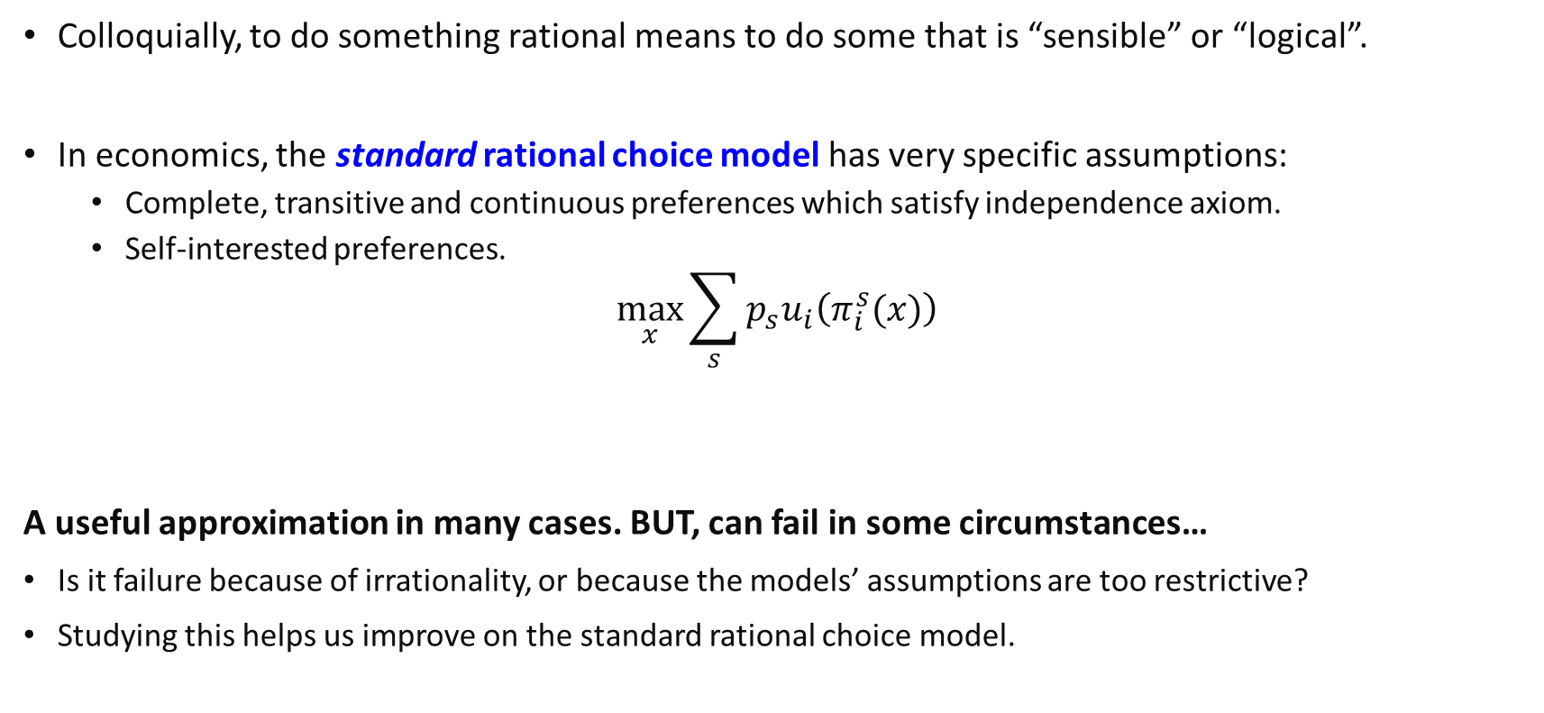

The Standard Rational Choice Model
Colloquially, to do something rational means to do some that is “sensible” or “logical”.
In economics, the standard rational choice model has very specific assumptions:
Complete, transitive and continuous preferences which satisfy independence axiom.
Self-interested preferences.
$$\max_{x}{\sum_{s}{p_{s}u_{i}\left(π_{i}^{s}(x)\right)}}$$
A useful approximation in many cases. BUT, can fail in some circumstances…
Is it failure because of irrationality, or because the models’ assumptions are too restrictive?
Studying this helps us improve on the standard rational choice model.
Payoffs from one’s choice $x$in state $s$
Probability of a state $s$

Slide 3
What Is Behavioral Economics?
Behavioral economics is the study of choices actually made by economic decision makers.
Purpose:
Assess strengths and weaknesses of the (standard) rational choice model
Improve on economic models and create better predictions.
Today, we will introduce several findings from behavioural economics.
No formal models, but you should be able to think about how they are applicable.
Notes:
This chapter defines a developing subfield of microeconomics that at times reinforces and at times contradicts the traditional theories of microeconomics.

Slide 4
Limited Cognitive Resources?

Slide 5

The Paradox of Choice
Implicitly in the maximization function.. (No cognitive constraints) Assumes that we are able to evaluate all possible options and make the best choice.. Is this true?
A simple test is whether people can become worse off from having more options
The rational choice model says “No.”
Contradicting Evidence?
The Medicare Drug Prescription Plan in the US offers over 1,000 additional insurance choices. However, most beneficiaries complain they can’t figure out how to choose. Most want fewer options!
Notes:
Body of literature which discusses how finite “cognitive resources” can influence behaviour.
Some have even applied this to the study of decision making under poverty.

Slide 6
Cognitive constraints
Suggests that people have cognitive constraints.
“… limitations in human information processing abilities, impacting memory, attention, and problem-solving capacities…”
Consequences
People may (unconsciously) use heuristics as cognitive shortcuts: may not always be the best.
Policies (e.g. targeting consumption, debt) may not always be effective…
When are cognitive constraints the most prevalent? (E.g. Situations of poverty lead to high stress and stronger constraints?)

Slide 7
Framing Effects

Slide 8
Reference Points
Which action would you choose in each of these scenarios?
Scenario A
600 lives are threatened.
Action (a) saves 200 lives.
Action (b) saves all 600 lives with probability 1/3 and saves nobody with probability 2/3.
Scenario B
600 lives are threatened.
Action (c) causes 400 to die.
Action (d) causes 600 to die with probability 2/3 and causes nobody to die with probability 1/3.

Slide 9
Reference Points
These problems are identical, apart from how they are framed.
Scenario A: “Gain Frame”; Scenario B: “Loss Frame”
The standard rational choice model predicts no differences: only the final payoff should matter. BUT, People usually choose a) over b), but d) over c)
These results reflect how individuals seem to be:
More sensitive to losses: i.e they are loss averse.
Risk averse in gains but risk seeking in losses.
Why? May not be useful nowadays, but such heuristics may have been beneficial in uncertain environments with potential large costs of mistakes.

Slide 10
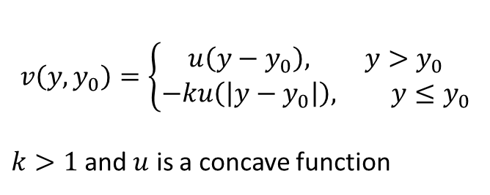
Accounting for reference points
Prospect theory (Kahneman and Tversky, 1979) aims to deal with this by incorporating these into the utility function.
v
v(y)
$$v\left(y,y_{0}\right)=\left\{\begin{aligned}u\left(y−y_{0}\right), y>y_{0} \\ &−ku\left(\left|y−y_{0}\right|\right), y≤y_{0}\end{aligned}\right.$$
$k>1$ and $u$ is a concave function
y<y₀
y>y₀
Can also explain other things like the sunk cost fallacy...
However, also leads to other questions: What determines reference points?

Slide 11
Non-standard Decision making under uncertainty

Slide 12
Non-linear probability weights
The rational model of expected utility theory assumes that probabilities are weighed evenly.
However, why do people gamble at casinos when they know that casinos make large profits because, on average, gamblers lose money?
Many people who buy a new appliance (for example, a refrigerator or a TV) also buy insurance against its failure in the early part of its life, even though the probability of a failure is very low and the expected value of the insurance is far less than its price.
Evidence suggests that people assign larger weights to very low probability events which is inconsistent with the expected utility model of choice.

Slide 13
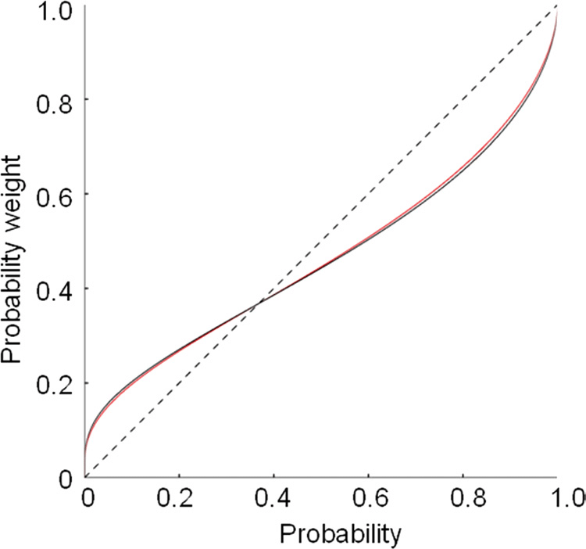

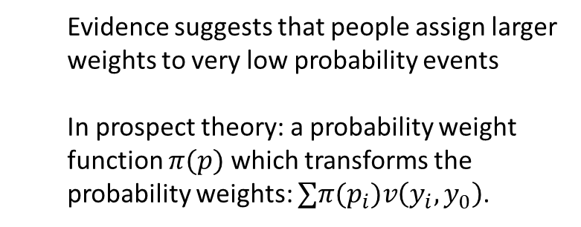

Non-linear probability weights
If people maximise expected utility, then hard to reconcile things like
Gambling (high risk seeking)
Insurance for rare accidents like electronic appliance failure (high risk aversion).
$$π(p)$$
Failure chance is low but overweighed
Evidence suggests that people assign larger weights to very low probability events
In prospect theory: a probability weight function $π(p)$ which transforms the probability weights: $∑π(p_{i})v\left(y_{i},y_{0}\right)$.
Winning chance is low but overweighed
$$p$$

Slide 14
The Gambler’s Fallacy
In statistics, the law of large numbers says that the mean of a large sample drawn randomly and independently from a population is likely to be very close to the mean of the population.
Kahneman and Tversky’s law of small numbers says that an individual’s choices are overly influenced by the outcomes in a small sample, especially if one “experiences” the sampling
When asking people to construct random sequences of coin flips, they are always too “balanced”.
When seeing black rolled more often on a roulette, more likely to believe that red will be rolled next.
The misconception that outcomes which have already appeared are less likely to occur in future for independent events (and vice versa) is called the Gambler’s Fallacy.

Slide 15
The Hot Hand Fallacy
Consider a gambling game which bets on a coin flip
Often, a player who has just won is more likely to continue to bet than is a player who has just lost.
The misconception that future events are likely to be similar to past events is called the Hot Hand Fallacy.
Notice that the Gambler’s fallacy instead predicts the opposite: a winner is less likely to continue.
What explains these differences?
Research suggests that the hot hand fallacy is more likely to occur when there is a focus on the outcome being a result of a (specific) individual doing the toss.

Slide 16
Non-Standard Intertemporal Preferences

Slide 17

Time-Inconsistency
The rational choice model assumes that your preferences are known to you and do not alter over time. If so, then a decision you make today about future behavior should be a decision you do not change as time goes by.
Decisions should be time-consistent if nothing unpredicted happens.
This is captured by exponential discounting which is widely used in economics .
The time-discount factor $δ$ between each period is constant.
$$Present Value of Utility=$$
$$u\left(x_{0}\right)+δu\left(x_{1}\right)+δ^{2}u\left(x_{2}\right)+…+δ^{T−1}u\left(x_{T}\right)$$
Payoff in current period
Payoff in 1 period’s time
Payoff in 2 period’s time
….

Slide 18
Time-Inconsistency
However, we often notice violations of this:
Today, you are sure you will finish your homework tomorrow. But tomorrow, you postpone doing your homework again.
Your sincere New Year’s resolution is to exercise regularly, but you don’t.
In experiments:
Prefer $10 today rather than $12 tomorrow BUT
Prefer $12 in 31 days to $10 in 30 days

Slide 19

Time-Inconsistency
We say that people often display time-inconsistency, in particular a present bias
They are more patient when making long term decisions than when making current decisions.
In behavioural economics, this is often modelled using hyperbolic discounting
A simplified version is the quasi-hyperbolic discounting model.
Discount factor is $βδ$ between today and tomorrow, and $δ$ between any two consecutive future periods.
$$Present Value of Utility=$$
$$u\left(x_{0}\right)+β\left[δu\left(x_{1}\right)+δ^{2}u\left(x_{2}\right)+…+δ^{T−1}u\left(x_{T}\right)\right], β<1$$
Today and $t$ periods ahead: $βδ^{t}$, Period $x$ and period $x+t$: $δ^{t}$. Today has higher weight!

Slide 20
Social Preferences

Slide 21

Altruism
Consider the dictator game: You, and only you, will decide how to divide $10 between yourself and one other person. This will happen only once. You don’t know who is the other person and the other person does not know who you are. How would you divide the $10?
Standard rational model’s prediction: you will take everything.
But most people give at least something to the other person. The smaller is the amount to be divided, the more likely it is to be divided equally.
In behavioural economics, this is often attributed to altruistic preferences, but other reasons like social image or fairness may also play a role.
$$U_{i}\left(x_{i}{,x}_{j}\right)=u\left(x_{i}\right)+βu\left(x_{j}\right), β≥0$$

Slide 22

Fairness
Consider instead the ultimatum game: You make an offer on how to divide $10. If the other person accepts then this is how the $10 is divided. If the offer is rejected then both get nothing. How would you divide the $10?
Standard rational model’s prediction: i) other will always accept you, and hence, ii) you will offer at most one cent to the other.
But most people refuse offers of about 3 dollars or less are refuse. Most offers are about 4 dollars and are accepted.
In behavioural economics, this is attributed to preferences for fairness:
$$U_{i}\left(x_{i}{,x}_{j}\right)=x_{i}−α\max\left(x_{i}−x_{j},0\right)−β\max\left(x_{j}−x_{i},0\right) α,β≥0$$
Envy from being behind
Guilt from being ahead
Notes:
The explanation is that the other person is offended if you try to keep a large part of the $10. Also, the cost to the other of refusing the offer decreases as you keep more for yourself. You understand this and so offer close to, but less than, $5.
The social norm of “fair” being about a 50-50 share results in a desire by the other to punish you if you are “unfair.”

Slide 23
Social Utility
These models are related generally to the idea that people get some utility from their social interactions with others.
They like being nice to others, and also perform social comparisons with others.
Where social utility is derived from can depend on social contexts. For example,
Who people compare themselves to depends on the people they interact with more often.
In social identity theory: people derive esteem from group belonging and group comparisons.
In social network theory: people gain utility from connecting to people who are alike to them.
This can have a wide range of consequences for the organization of society and social welfare.
For example, even within affluent societies, there exists a wide range of happiness (subjective well-being) due to social comparison.

Slide 24
Applications

Slide 25
Welfare implications (Chetty, 2015)
Improving on models of human choice, gives us new policy tools: more scope for efficient policy
Example: changing defaults and automatic enrolment plans can improve retirement saving. Highlighting social norms to reduce petty crime. Reducing conflict through changing social preferences.
Improved models allows us to make better predictions about the effects of existing policies
E.g. Effects of minimum wages.
Improved models generates new welfare implications by delving into how decision utility may differ from experienced utility (e.g. self control, time preferences).
Can identify where improvements to people’s welfare can be made.
Implications of relative income and caring about social status?

Slide 26
Paternalism?
Interventions based on the assumption that people may have certain biases may be too paternalistic and infringes on their freedom.
E.g. your parents giving you a curfew on staying out. The government banning e-cigarettes.
Nudges (Thaler and Sunstein, 2008), aim to shape the choice context to influence people’s choices to become better without restricting their ability to choose.
Libertarian Paternalism
Libertarian: policies that maintain or increase freedom of choice.
Paternalism: influencing choices in a way that “will make choosers better off, as judged by themselves”.
Example: changing the default option of a savings plan while still letting people opt out. Seems effective because people do not regret taking the default option.

Slide 27
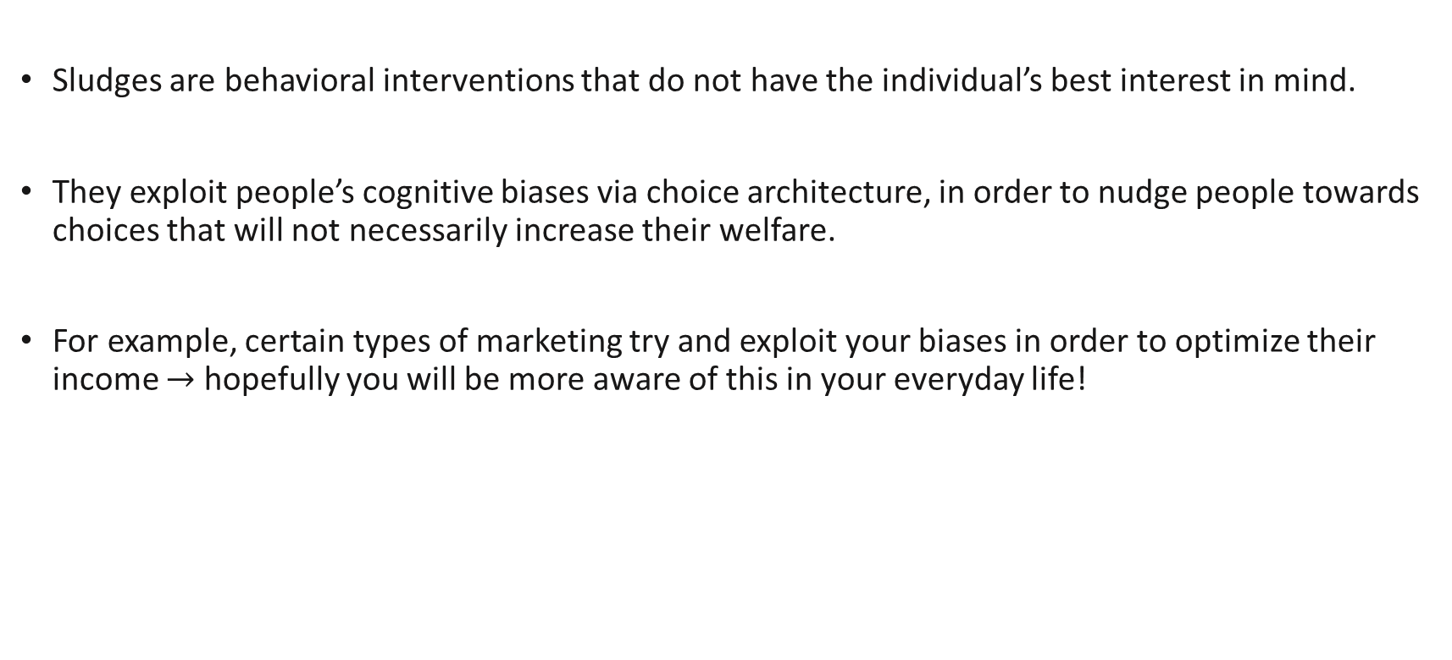
Sludges
Sludges are behavioral interventions that do not have the individual’s best interest in mind.
They exploit people’s cognitive biases via choice architecture, in order to nudge people towards choices that will not necessarily increase their welfare.
For example, certain types of marketing try and exploit your biases in order to optimize their income $→$ hopefully you will be more aware of this in your everyday life!

Slide 28

A case study…?
“The university has launched a new initiative to encourage greater participation in the SFT. To encourage more robust feedback from students, we are offering them the opportunity to view their exam results earlier than the usual results release date. Effective this semester (AY24/25, Semester 1), students who complete at least 75% of all their SFT surveys for the semester will receive their examination results earlier, on 2 Jan 2025, instead of 6 Jan 2025.”
Completing feedback $→$ “Benefits”
Standard date if comply and late date if do not comply.
vs
Early date if comply and standard if do not comply
Students want to get results together?
Coordination problem.

Slide 29
Key Learning Outcomes
How does actual human behaviour deviates from standard rational behaviour?
What are the alternative models/theories which are used to explain this in the literature?
Be able to identify scenarios where behavioural economics can be applied.

Slide 30
References
Varian, Chapter 31 (contains some material covered here)
Raj Chetty; 2015, Behavioral Economics and Public Policy: A Pragmatic Perspective

